Slide 1
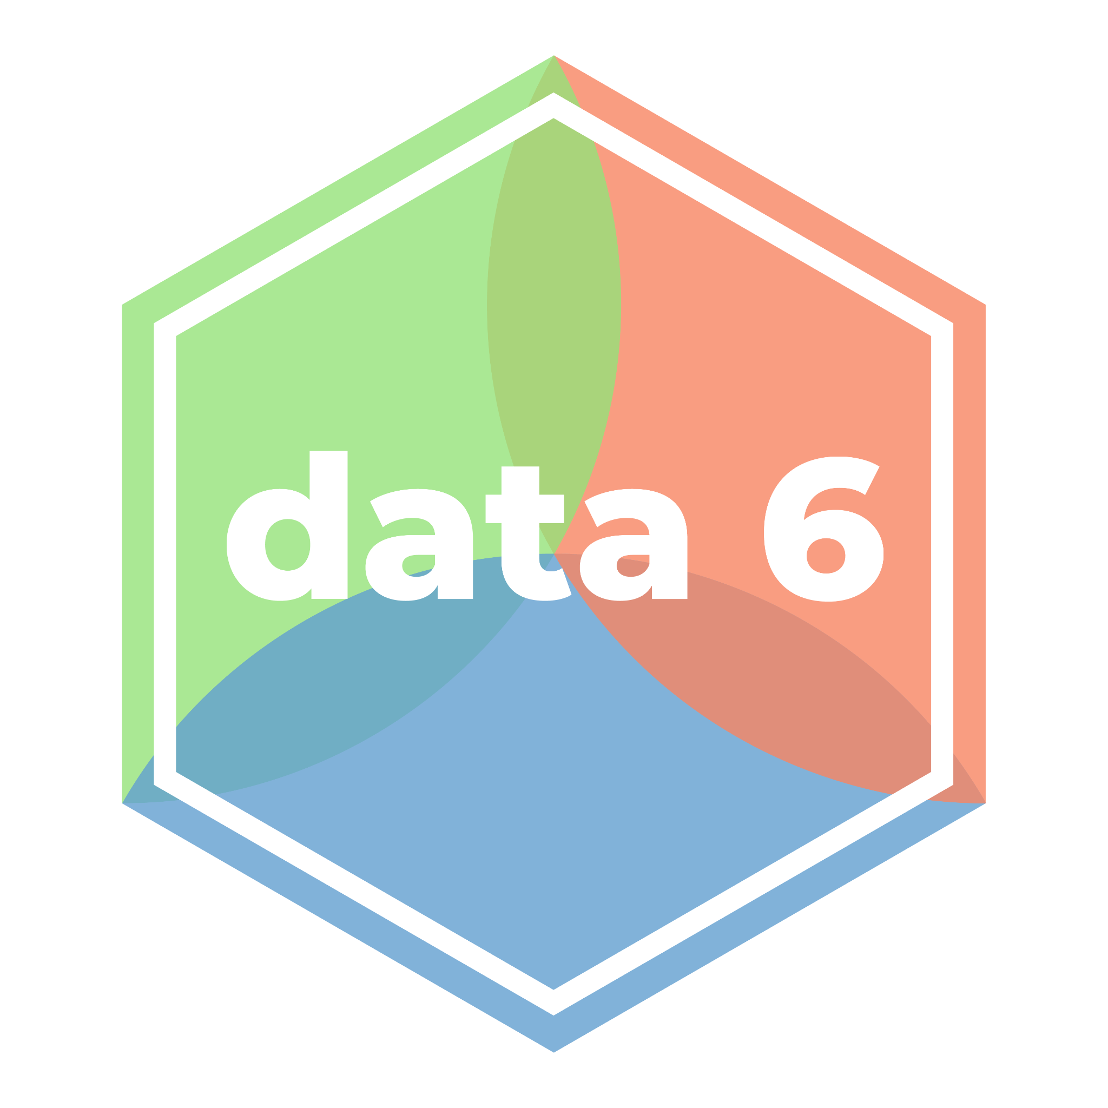
Introduction
LECTURE 01
Defining data science and computational thinking, and discussing course learning objectives and logistics.
Spark 010 - Thinking With Data - Spring 2024
Developed by students and faculty at UC Berkeley and Tuskegee University
data6.org/su23/syllabus/#acknowledgements-

Slide 2
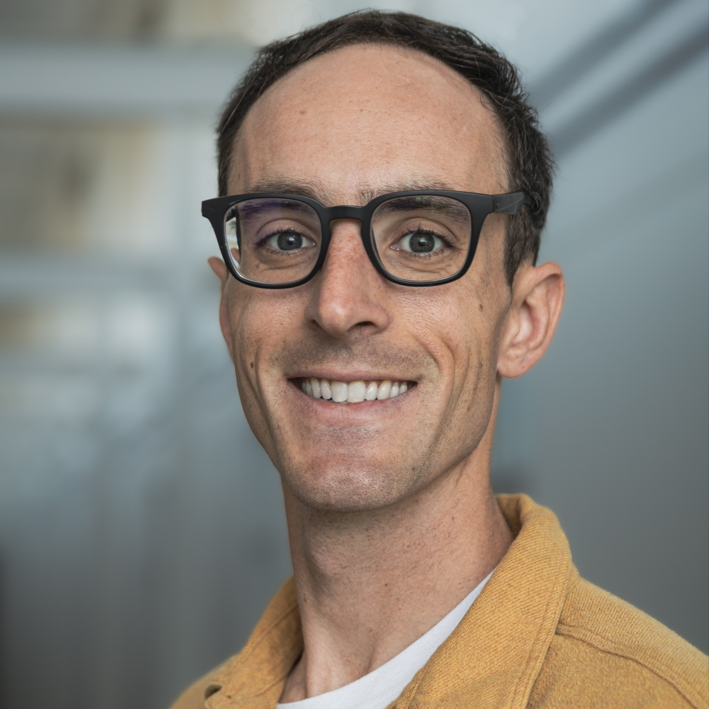
Adrien Peltzer
Instructor | apeltzer@ucmerced.edu
Hi y’all! I’m a third-year Lecturer from UC Riverside / UC Irvine / So Cal. At UCR, I majored in Pure Math with a minor in Philosophy. At UCI I got a PhD in Probability and Number Theory. Now I’ve transitioned to Data Science. I love exercising, doing/teaching math, drinking coffee, and watching NBA.
catcourses

Slide 3
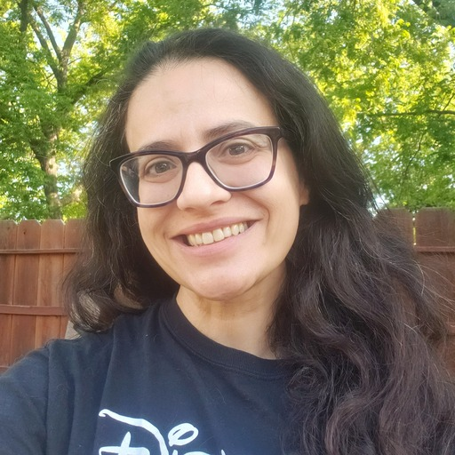
Suzanne Sindi
Co-Instructor | ssindi@ucmerced.edu
I’m a Professor of Applied Mathematics and the Department Chair! I work in mathematical biology and data science. I’m excited to work in a new environment (JupyterHub) and teach folks about data, data science :)
catcourses

Slide 4
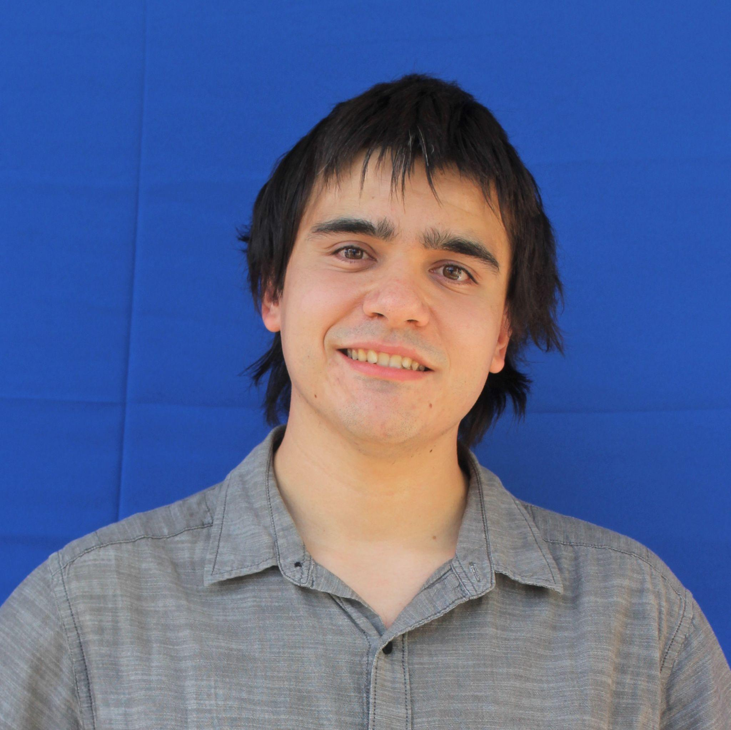
Spark 010 Course Staff
Jordan Collignon
Course Advisor | jcollignon@ucmerced.edu
Jordan is a graduate student in the Applied Mathematics Ph.D program at UC Merced working in Mathematical Biology. I’m excited to help make data science easier to learn for students across different technological and scientific backgrounds. I like to take pictures, find new places to eat, and play Nintendo games.
catcourses
Notes:
10:20

Slide 5
Getting to Know You
Now it’s your turn!
Notes:
10:15

Slide 6
Today’s Roadmap
What is data science? What is computational thinking?
What will you learn in this class?
How will this class be run?
Fun demo
Lecture 01, Spark 010, Spring 2024

Slide 7
What is Data Science?
➤
1. What is data science?
2. What will you learn in this class?
3. How will this class be run?
4. Fun demo

Slide 8
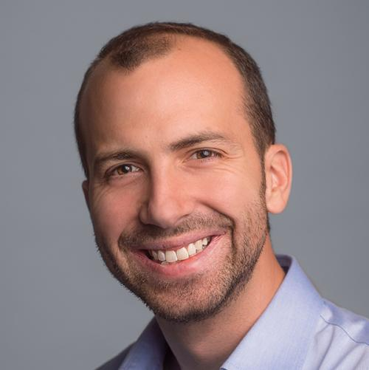
Joey Gonzalez
“Data Science is the application of data centric, computational, and inferential thinking to:
Understand the world
Solve problems”
Creator of Data 100

Slide 9
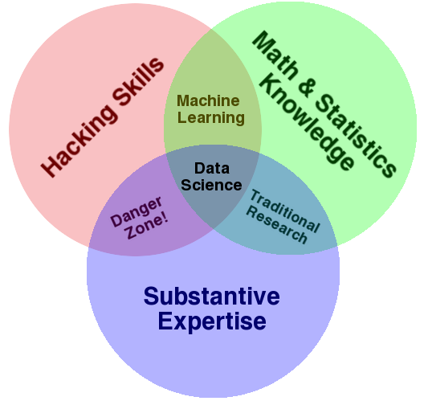
Data science is a fundamentally interdisciplinary field
by Drew Conway in 2010 (link)

Slide 10
Data 6 Version
Machine Learning
Computational Thinking
Statistics and inference
DS
Engineering
Research
Domain knowledge and social contexts

Slide 11
Example Questions in Data Science
Data science is all about asking questions and answering them with data.
Is the world getting better or worse?
Is the use of the COMPAS algorithm for prison sentencing fair?
Where should we put docking ports for our bikes?
What should we eat to avoid dying early of heart disease?
Do immigrants from poor countries have a positive or negative impact on the economy?
Will there be a third? fourth? wave of COVID-19?

Slide 12
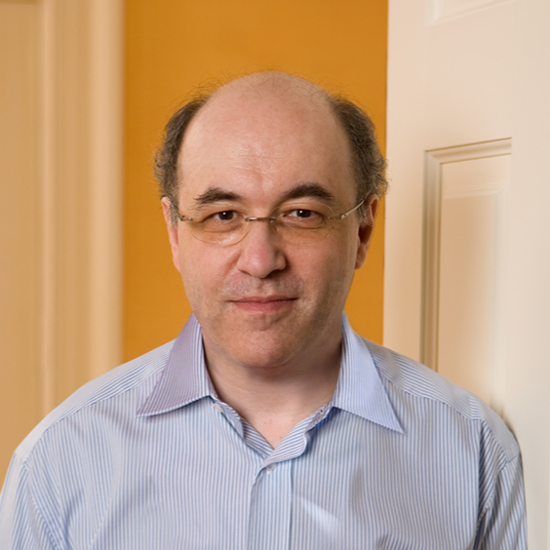
Computational Thinking
Stephen Wolfram
“Computational thinking is about formulating things with enough clarity, and in a systematic enough way, that one can tell a computer how to do them.”
Creator of WolframAlpha

Slide 13
In Other Words:
Computer science and computational thinking aren’t inherently about computers! They’re just tools.
Computational thinking involves an element of creativity, as there are often many ways to solve a given problem.
Notes:
10:20

Slide 14
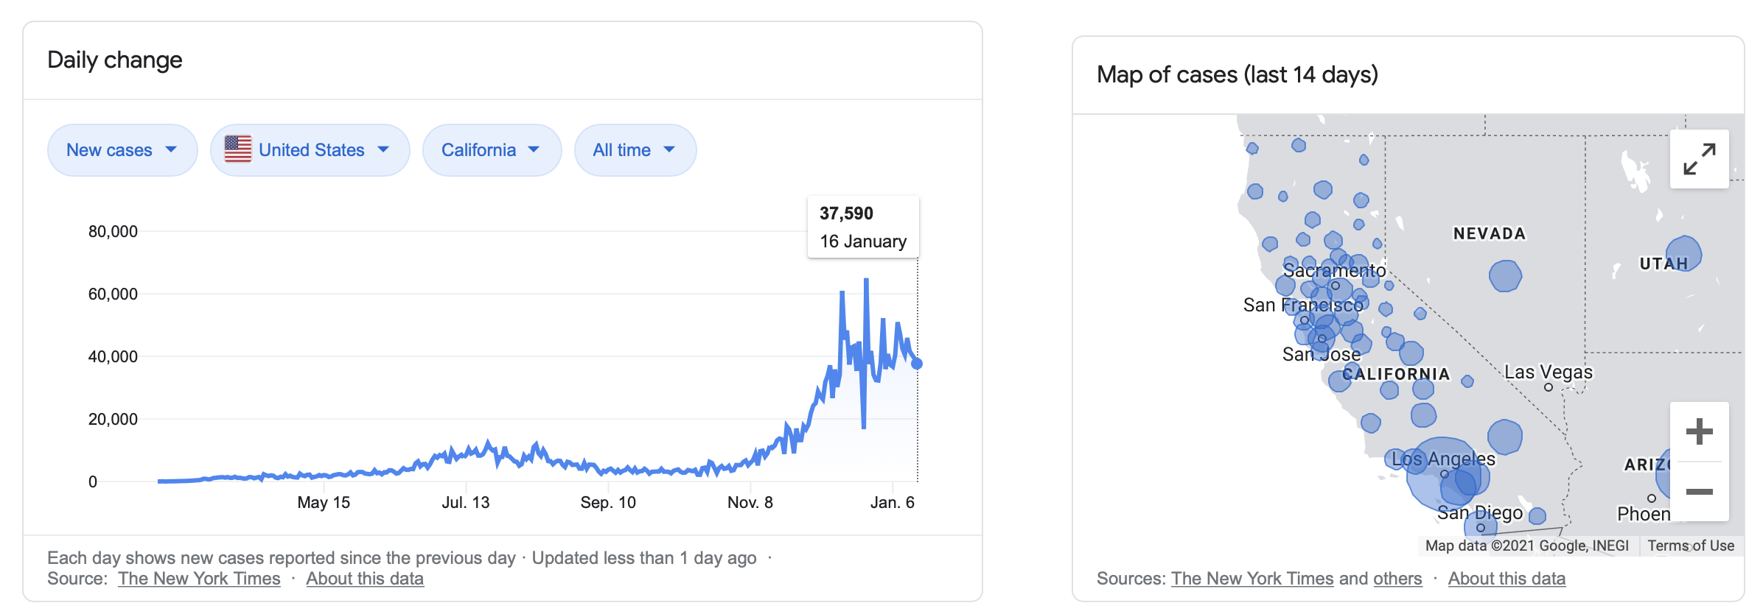
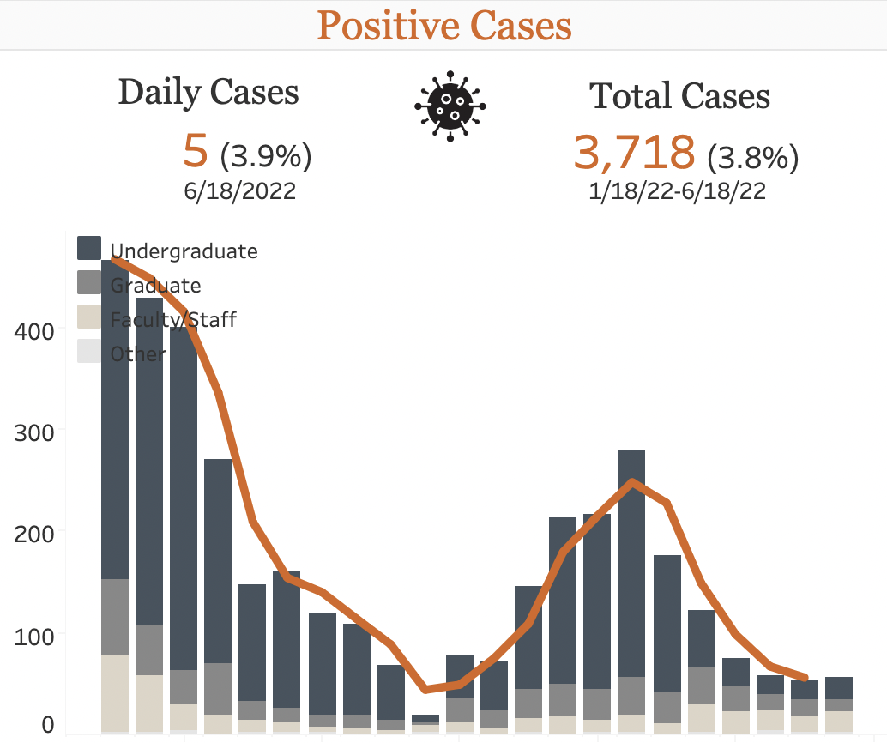
Social Implications:
Data science drives policy and public understanding

Slide 15
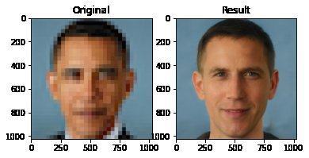
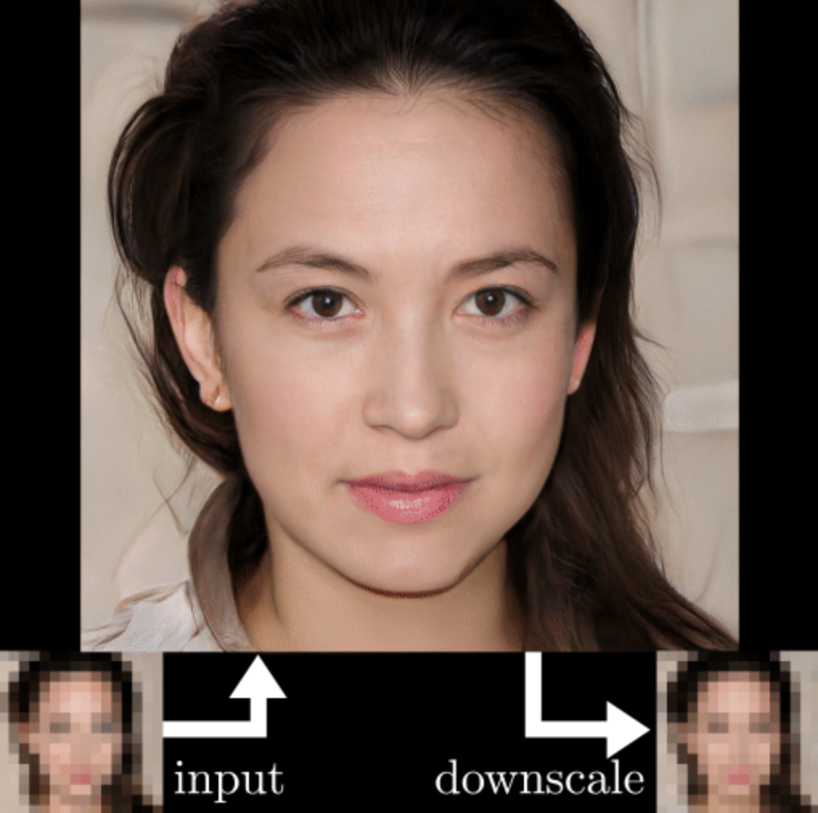
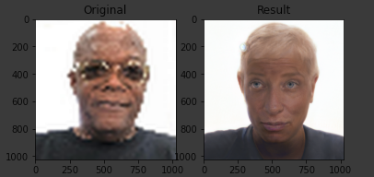
Social Implications:
Unconscious and implicit bias
A “depixelizer” (link) was built that takes pixelated images and generates images that are perceptually realistic and downscale correctly.
What do you notice? Why might this be happening?

Slide 16
Content and Learning Objectives
1. What is data science?
2. What will you learn in this class?
3. How will this class be run?
4. Fun demo
➤

Slide 17


Introduction to Computational Thinking with Data
As the title suggests, this class will teach you how to make computers to do interesting things involving data.
In order to tell our computers what to do, we will use the Python programming language.
While at points it may feel like this is a class about Python, this class is really about teaching you how to solve problems, particularly those involving real-world data.
At the end of the semester, you will be strong computational thinkers, and will be able to apply the skills you’ve learned to projects of your own.

Slide 18
Thinking with Data Course Content
Introduction to Python and Jupyter Notebooks
Data Visualization
Working with Tabular Data
More Python and other fun things time permitting!!
In the first few weeks, it won’t really feel like we’re doing “data” science – we need to walk before we can run! We’ll try to incorporate as much real data as we can in the first few weeks, though.

Slide 19
Course Logistics
1. What is data science?
2. What will you learn in this class?
3. How will this class be run?
4. Fun demo
➤
Notes:
10:25

Slide 20
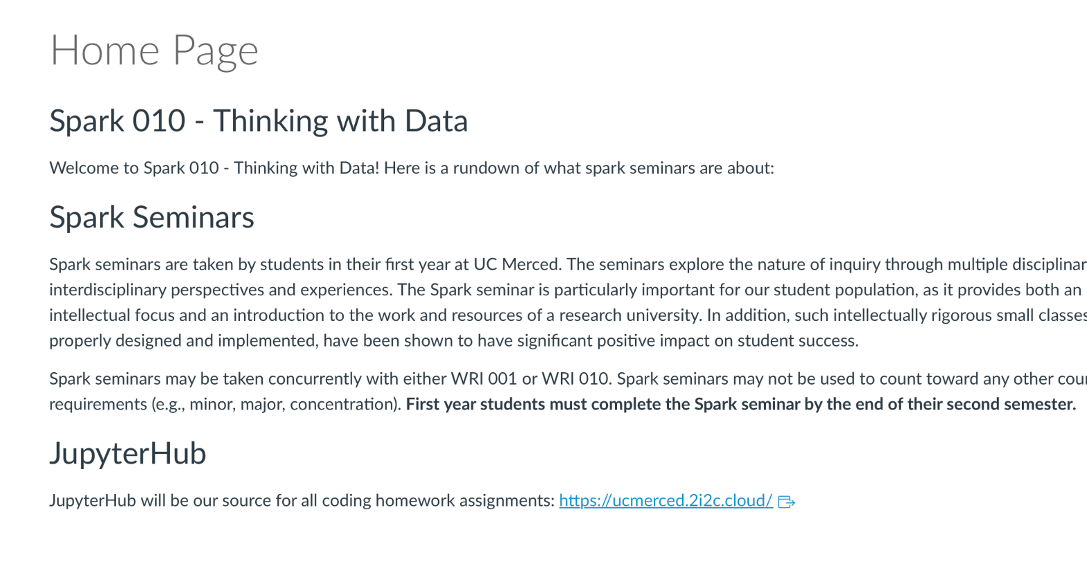
Technology
Course website (https://catcourses.ucmerced.edu/courses/31104): where all content is posted.
No textbook! (all materials available online)
JupyterHub (https://ucmerced.2i2c.cloud/): All Homework sets will accessed through this link!
Homeworks Course Page (https://catcourses.ucmerced.edu/courses/31104/pages/notebooks) All Homework assignments will be in the form of Jupyter Notebooks. They are accessible here!

Slide 21
Course components
What | When | Why
Lecture | MW 330-420 (ADMIN 360) | Introduce new ideas,
Homework |  | Practice skills from lecture
Office Hours | Suzanne (ACS 366): Mon: 4:30 - 5:30pm Adrien (ACS 330B): Wed: 4:30-530 pm Jordan (ACS 358A): Tues & Thurs: 10:00-12:00pm | Get help on homework, Learn about data science, Get to know us as people (and we get to know you too)! Talk and learn about careers in data science!

Slide 22
Grading
Component | Weight
Participation | 15%
Attendance | 5%
Homeworks | 40%
Mid-Semester Project | 20%
Final Project | 20%
Notes:
Participation, homework, mid-semester and final projects.

Slide 23
Participation & Attendance
Participation is worth 15% of your final grade. The Participation category consists of:
Lecture Participation
Asking questions.
Helping others.
Completion of In-Class Assignments
Submitted on time
Complete, Effort and Attempt
Notes:
For lectures quick checks and (maybe) lecture participation would apply.
Office hour participation may be a long shot.

Slide 24
Homeworks
You learn data science by doing, not by reading or listening. As such, the biggest component of your grade is homeworks!
Homework will be roughly weekly.
Most homework assignments will involve at least a teeny bit of computing!
But we are here to help! And we do not assume any prior programming experience.
Homeworks will be due just before class on Wednesday’s and a new assignment will be given that same Wednesday.

Slide 25
(Short) Projects
You will have a Mid-Semester Project and a Final Project
These short projects will have you analyzing data either from the instructor or of your own choosing!
The goal is for you to interact creatively with data to make your own discoveries!

Slide 26
Fun Demo!
https://ucmerced.2i2c.cloud/
1. What is data science?
2. What will you learn in this class?
3. How will this class be run?
4. Fun demo
➤
Notes:
What is our fun demo?

Slide 27
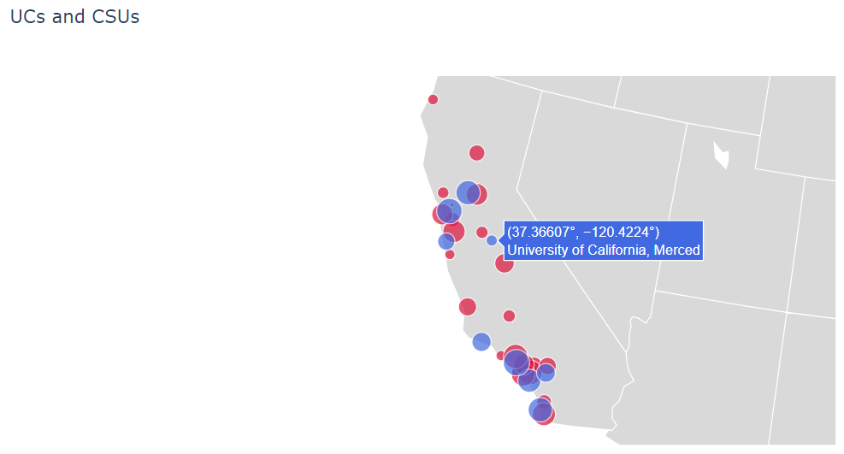
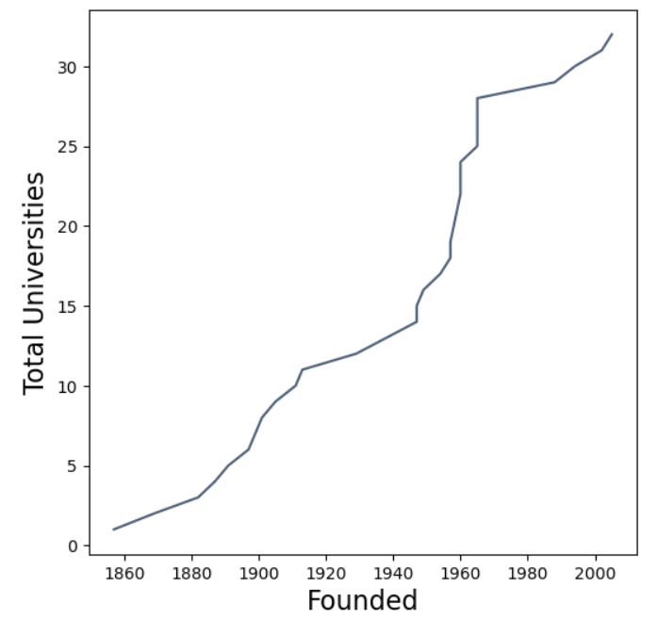

Slide 28
# of CSUs and UCs in California over time

Slide 29
Accessing JupyterHub
Go to https://ucmerced.2i2c.cloud/
Select Python
You have a file system (just like on any other computer)
Create a new folder that you will use for this class.
Copy the “Lecture 01” folder into the folder you created.
Open the file “lec01.ipynb”.
On the top, go to “Run”, then select “Run All Cells”.

Slide 30
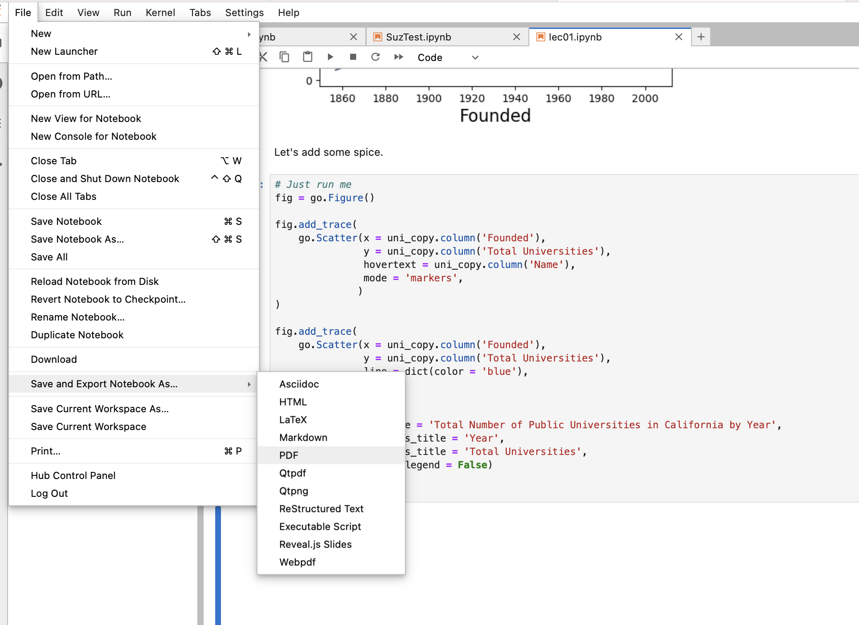
How to get Credit? (For today and all days!)
Export the Lecture 01 file (lec01.ipynb) as a PDF and upload it to Assignment 1 - Notebook Upload
Go to file->
Save and Export Notebook As …_>
PDF

Slide 31
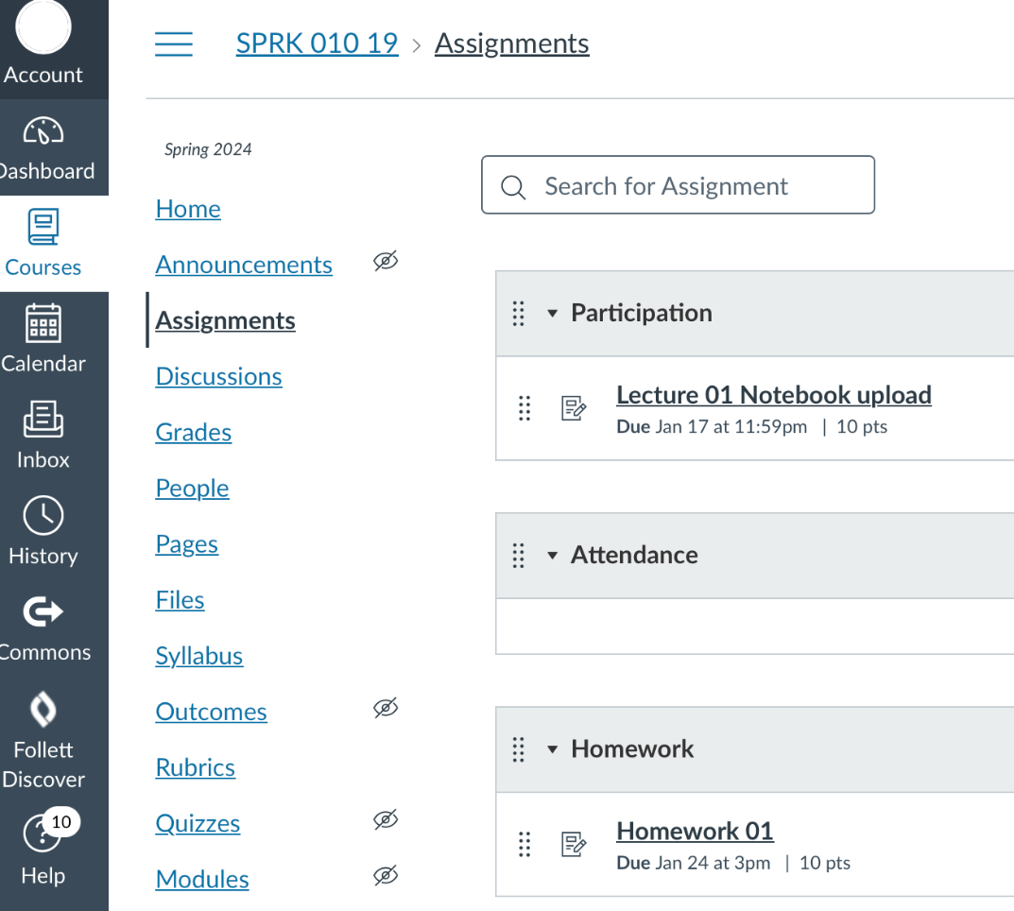
How to get Credit? (For today and all days!)
Export the Lecture 01 file (lec01.ipynb) as a PDF and upload it to Assignment 1 - Notebook Upload
Go to Catcourses->
Assignments->
Assignment 1- Notebook Upload
Upload your submission
and you’re off the hook for today!

Slide 32
In Conclusion…
Notes:
10:50-10:55

Slide 33
Recap
Next Time
What is data science? What is computational thinking?
What will you learn in this class?
How will this class be run?
Fun demo
What is code?
How do we run code?
Arithmetic.
Running our first programs.
Comments, number types, and errors.

